Slide 1












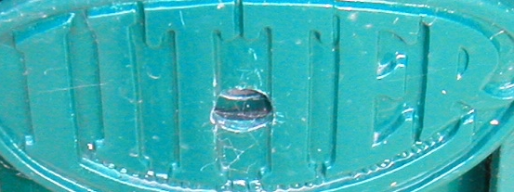





Reflections/ Transparency
Shadows
Specularity
Low Contrast
Noise
Blur

